Slide 1

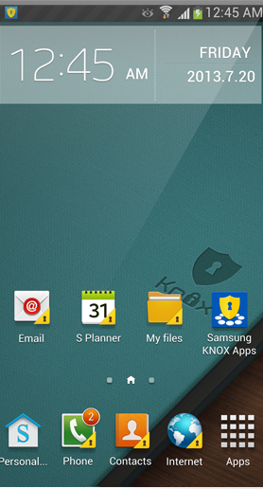

KNOX
The Next
Secure Enterprise
Mobile Platform

Slide 2
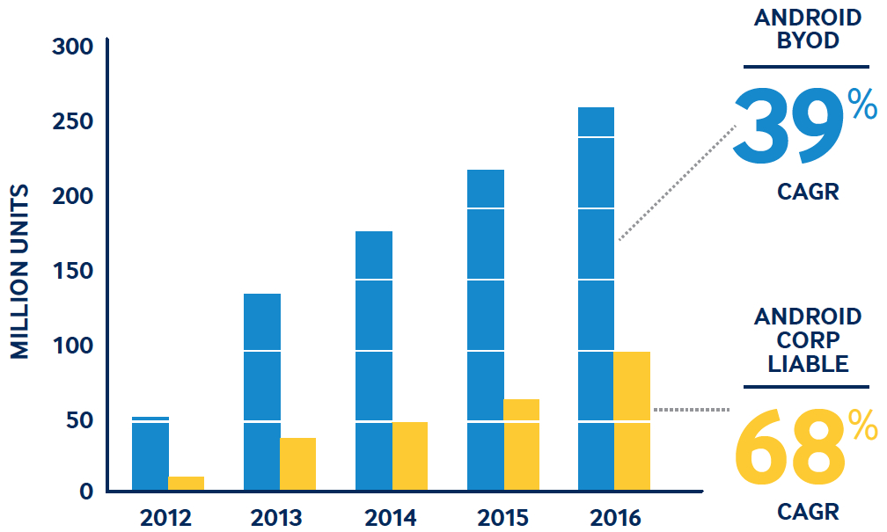
Significant Android Growth in Enterprise
CAGR: Year-over-year growth rate over this period of time.
*IDC, 2013, Worldwide Business Use of Smartphone Forecast
Notes:
BYOD= Bring your own device
COPE= Company owned personally enabled or corporate liable for the devices
CAGR= Year over year growth rate over this time period of growth

Slide 3
Android Acceptance in Enterprise is Low*
Why?
Consumer
Enterprise
#1
Lack of Security
75%
Of smartphone users have Android phones
# of enterprises deploying Android phones in the next
12 months
Limited
Manageability
#2
<10%
*Gartner, Strategies to Solve Challenges of BYOD in Enterprise, 2013
Notes:
Lack of platform security
Lack of information security
----- Meeting Notes (12/20/13 15:27) -----
"Android acceptance in enterprise is low”

Slide 4



“79% of Mobile Malware
Targets Android”²
“Android
Security
Flaw
Uncovered”¹
Unclassified memo from the U.S. Department of Homeland Security and the Department of Justice
“Android
Phones are
Pocket-sized
Data Mines”³
¹Data-Tech, 7/16/2013, www.datatechitp.com/android-security-flaw-uncovered/,
²Angela Moscaritolo, 8/28/2013, PC Magazine, www.pcmag.com/article2/0,2817,2423705,00.asp
³Max Eddy, 7/8/2013, “You Need Mobile Security for Android, But Not Because of Malware,” http://www.pcmag.com/article2/0,2817,2421366,00.asp

Slide 5

As BYOD Explodes –
IT Has Reason to be Concerned
Over 50% of CIOs indicated their secure
IT network was breached
due to employees using personal services
Virgin Media Business, 2013, interviews with 500 leading British CIOs

Slide 6
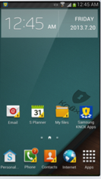

Samsung KNOX
Samsung’s Secure
Android Platform
Notes:
----- Meeting Notes (12/20/13 15:27) -----
add "Samsung" above KNOX

Slide 7



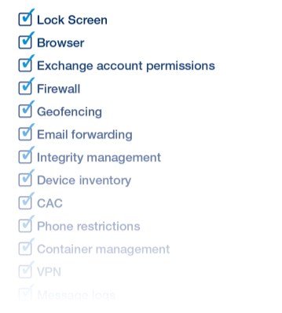
Samsung KNOX | Secure Android Platform & Best in Class Device Manageability
MDM Policies
KNOX Container
KNOX Framework
Security Enhancements for Android
TrustZone Integrity Management Architecture
Secure Boot/Trusted Boot
ARM TrustZone Hardware
Over 500 MDM Policies
Secure Android Mobile Platform
Protected Apps & Information
Powerful Control of Devices
Notes:
----- Meeting Notes (12/20/13 15:27) -----
-text in the phone needs to be fixed: "TrustZone Integrity Management Architecture" in 2 lines
-white text in yellow box is hard to read -> different color?
-change: secure enterprise mobile platform -> Secure android platform
when the two other boxes fade out, the title should change (it's not working the way we had hoped)
Instead of the grey fadeout we want the two boxes to completely be removed and the main topic box to be centered (please let me know if you need more explaination)

Slide 8



Samsung KNOX | Secure Android Platform
KNOX Container
Dual Persona for Work & Play
KNOX Framework
MDM Policies, Data Encryption, VPN, Identity Management
Security Enhancements for Android
Security Enhancements for Android
TrustZone Integrity Management Architecture
Hardware Assisted Rooting Prevention & Detection
Secure Boot/Trusted Boot
ARM TrustZone Hardware
Notes:
----- Meeting Notes (12/20/13 15:27) -----
- this slide should come before the ecosystem slide before this
- secure android platform
- security enhancements for android → SE for Android (change the lowest blue box to this)
-(mi

Slide 9
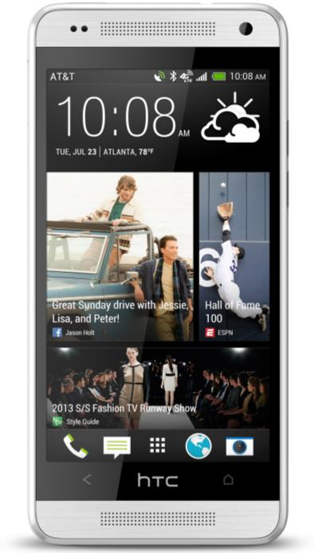



Secure Platform | Security Built into Every Layer
Android Open Source Project (AOSP)
Application Layer
KNOX Container
Android Framework
KNOX Framework
Android OS
Security Enhancements for Android
Linux Kernel
TrustZone Integrity Management Architecture
Boot Loader
Secure Boot/Trusted Boot
Hardware
ARM TrustZone Hardware
Notes:
Combine slide 9 and 10 (paste all the text next to the phone) and keep the title as the first slide

Slide 10




Secure Platform | Secure Boot & Trusted Boot
ARM TrustZone
Kernel verified and loaded
Certificates are verified at each boot loader, once verified the next boot loader is loaded and verified
If values match, key is released and device continues to boot
Notes:
----- Meeting Notes (12/20/13 15:40) -----
"certifictes... " --> multiple boot loaders verified before start-up

Slide 11

Secure Platform | TrustZone Integrity Measurement Architecture (TIMA)
Linux Kernel
01010
00100
01100
01010
00101
01100
01010
00100
01101
01011
00100
01100
TIMA
TIMA checks Linux Kernel at boot
TIMA rechecks periodically as long as device is running
Notes:
TIMA monitors the integrity of the kernel two ways

Slide 12
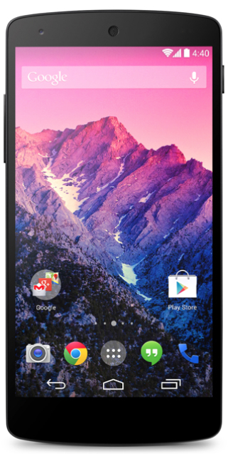
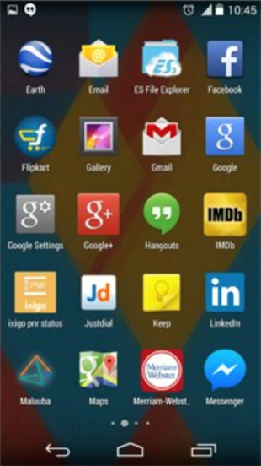
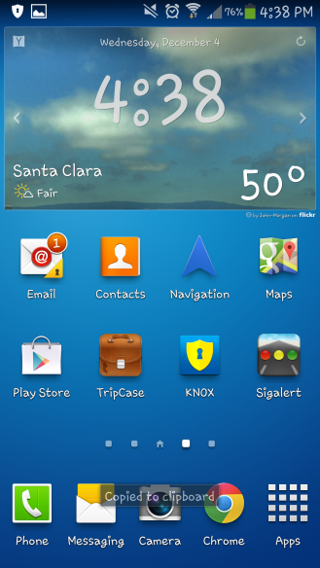

Secure Platform | SE for Android Protects Device & OS from Malicious Apps
When a malicious app roots an Android it can affect the entire device
KNOX uses Mandatory Access Control (MAC) to prevent malicious apps from running and preventing system wide damage
Notes:
KNOX implements a trusted boot sequence that extends to the Android kernel.
Enterprise features are activated only if the boot process is verified
This ensures that enterprise security is not compromised if the boot-loader and/or kernel are replaced by a hacked version.

Slide 13





Secure Platform | Defense Grade Security
Approved by US DoD¹ based on STIG²
FIPS³ -Certified VPN
IM(Integrity Management)
CAC⁴ Support
1) DOD: Department of Defense
2) STIG: Security Technical Implementation Guide
3) FIPS: Federal Information Processing Standard
4) CAC: Common Access Card

Slide 14
Samsung KNOX | Secure Android Platform & Best in Class Device Manageability
MDM Policies
KNOX Container
KNOX Framework
Security Enhancements for Android
TrustZone Integrity Management Architecture
Secure Boot/Trusted Boot
ARM TrustZone Hardware
Over 500 MDM Policies
Secure Android Mobile Platform
Protected Apps & Information
Powerful Control of Devices
Notes:
----- Meeting Notes (12/20/13 15:53) -----
- SEMP --> secure android platform
need consistency in the title - protected apps & data
Instead of the grey fadeout we want the two boxes to completely be removed and the main topic box to be centered (please let me know if you need more explaination)

Slide 15
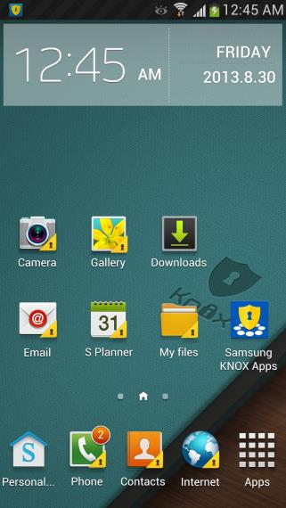


Protected Data & Apps | Safe & Secure Container for Enterprise Apps & Data
Enterprise
Personal
Separate container keeps enterprise data & apps safe
Notes:
----- Meeting Notes (12/20/13 15:53) -----
image size should be the same
Image of a guy in a suite on the enterprise side
*** will provide another image of the home screen without the icon, copied to clipboard, different font, etc

Slide 16
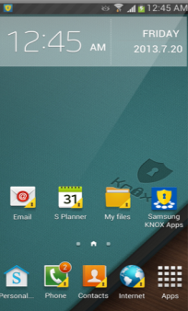







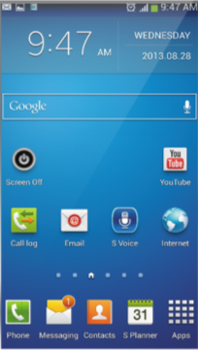




Protected Data & Apps | Per App VPN Tunnel
Enterprise KNOX
Encrypted Data Secure Through
VPN Tunnel on Enterprise Network
Personal
Completely Separate, Non-VPN Connection Frees Enterprise Resources & Ensures Privacy

Slide 17
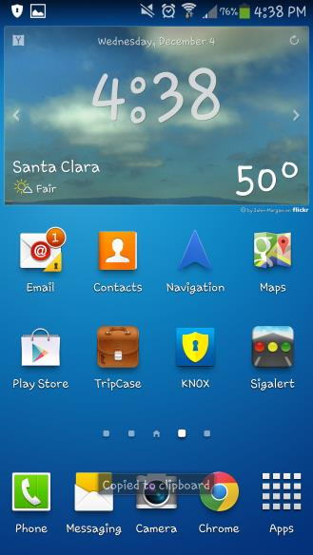
Protected Data & Apps | On-device Data Encryption Protects Container
Enterprise
Personal
Secure container is encrypted
SD cards are encrypted

Slide 18

Protected Data & Apps | On-device Data Encryption Protects Entire Device
Enterprise
Personal
Notes:
----- Meeting Notes (12/20/13 15:57) -----
- add text:

Slide 19









Protected Data & Apps | Single Sign On* (SSO)
No SSO
Enterprise Accounts
Enterprise Active
Directory Server
Enterprise Accounts
*Provided by Centrify
Notes:
Multi-application SSO is built into the Knox Container
The container identifies the user to the apps
The container can get AD attributes for the apps
Apps can request security tokens for their web app/service
password is stored and doesn't need to be reentered each time

Slide 20
























Protected Data & Apps | Hundreds of Popular Business Apps at KNOX Apps Store
OfficeSuite 7
Pro
Conversion
Calculator
GotoMyPC
CloudON
powerOne
Business
Calculator - Lite
GotoAssist
Customer
SAP Payment
Approvals
GoFormz
Evernote
ClickMobile
Onvelop
docLinker
Scan & Fill
Clarizen
SAP Travel
Expense
Report
Business
Card Reader
harmon.ie
Dropbox
Podio
Citrix
Receiver
powerOne
Finance
ISO 14971
Audit
ShareFile
More added every day…

Slide 21
Samsung KNOX | Secure Android Platform & Best in Class Device Manageability
MDM Policies
KNOX Container
KNOX Framework
Security Enhancements for Android
TrustZone Integrity Management Architecture
Secure Boot/Trusted Boot
ARM TrustZone Hardware
Over 500 MDM Policies
Secure Android Mobile Platform
Protected Apps & Information
Powerful Control of Devices

Slide 22
Mobile Device Management | Over 500 Policies Implemented From Over 1000 APIs
KNOX empowers enterprises to manage security in these areas:
Container
SE for Android
Integrity Management
VPN
Single Sign-On (SSO)
Common Access Card (CAC) or
SmartCard
Data
Password
Apps
Exchange
VPN
Restrict Access
Kiosk
Geo Fencing
Enterprise License Management (ELM)
Notes:
KNOX technical details
Container
Install the KNOX container with a launcher icon, home screen and preloaded apps
Lock the container, which requires the user to enter their KNOX password to unlock
Uninstall the container
Install or uninstall an app in the container through Samsung KNOX Apps
Add or remove an app launcher icon on the KNOX home screen
Define a whitelist or blacklist of apps that can be installed in the KNOX container
Start or stop an app in the container
Write data to an app's home directory
Create a firewall around the container (for example, block the FTP port on the device from receiving connections, or block the device from connecting to the HTTP port on a web server)
Define the password policy (same capabilities as the SAFE password)
Enable or disable camera, non-secure keypad and share via list
SE for Android
Set the enforce status of SE Linux
Set the enforce status of the Android Activity Manager Service (AMS)
Write SE Linux policy file to SE for Android
Write policies for SE for Android security contexts
Map apps to SE for Android security contexts
Integrity Management
Add apps to the baseline scan
Perform a pre-baseline scan
Establish the kernel measurement baseline
Scan the kernel or installed apps in real time
Start or stop the continuous runtime integrity monitoring
Define a subscriber to receive integrity violations and results
Update the existing baseline with the new scan result
VPN
Add or remove a VPN profile
Add or remove an app to or from a VPN profile so that when the app is launched, it uses a specific VPN
Add all apps in the container to a VPN profile
Enable a default forwarding route through defined network nodes
Set the CA certificate or user certificate for a VPN profile
Enable FIPS mode
Single Sign-On (SSO)
Define a whitelist or blacklist of apps allowed to use the SSO service
Set user information
Force user to re-authenticate
Common Access Card (CAC) or SmartCard
Enable or disable CAC or SmartCard authentication for the browser or email
SAFE technical details
Data
Start encryption and decryption on a device's internal memory or external SD card
Wipe internal memory or the external SD card
Lock out the device with a specific password
Install or remove the certificates used to authenticate users for email, Wi- Fi or VPN
Set the device enrollment status with the MDM server
Power off a device
Password
Set the policy for user password patterns
Set a blacklist of strings that are not allowed in passwords
Set the number of failed password attempts before a device is disabled
Set the time a password is valid, before it must be changed
Set the number of previous passwords that cannot be used for a new password
Show the user the password as it is entered
Apps
Install, update or uninstall an app on a device
Disable the uninstallation of an app
Force all apps to be installed on an external SD card
Get a list of the apps installed on a device
Start or stop an app used on a device
Check if an app is currently in use
Get info about an app: package name, version, how much RAM/CPU/network traffic it is using, the size of code/data/cache required, last time it was launched and how long it was used
Back up or restore a device’s app data and preferences
Wipe data associated with an app
Define a whitelist or blacklist of apps or widgets that can be installed
Disable or re-enable the native browser, Play store, voice dialer, or YouTube
Add an app launcher icon to the home screen and change an app's launcher icon
Enterprise License Management (ELM)
Activate an enterprise license, which enables enterprise apps to access the MDM APIs
HIDE DETAILS
Exchange
Add or delete an MS Exchange ActiveSync account
Set the account host, domain, username, email address, password
Enable or disable Secure Sockets Layer (SSL) security
Indicate if all certificates accepted for SSL
Set the certificate to be used for SSL authentication
Enable S/MIME certificates
Synch the account with the device contacts, calendar, tasks and notes
Enable device vibration for a new email
VPN
Allow only IPsec or SSL/TLS connections
Create, update or delete a VPN profile
Configure the profile: ID, pre-shared key, CA certificate, user certificate, secret, encryption, DNS search domains/addresses and network node forwarding route
Restrictions
Enable or disable Android Beam, apps not from Google Play, audio recording, background process limits, backups to Google cloud, Bluetooth, camera, cellular data, clipboard, factory reset, Home key, microphone, mock GPS locations, NFC, OTA O/S upgrades, power button, S Beam, SD card writing, S Voice, screen captures, settings changes by user, Share Via list, status bar, tethering, USB debugging, USB storage, video recording, VPN, wallpaper and Wi-Fi
Kiosk
Enable or disable Kiosk mode, which provides a restricted version of the default Samsung home screen
Enable or disable hardware keys, multi window mode or recently used apps display
Hide the navigation bar, status bar or system bar
Geo Fencing
Create or destroy a geofence area, which can be linear, circular or polygonal
Determine if a device is within the geofence area
Set the minimum distance and time interval to monitor a geofence
Start or stop geofence monitoring

Slide 23

Mobile Device Management | MDM Partners
KNOX technical details
Container
Install the KNOX container with a launcher icon, home screen and preloaded apps
Lock the container, which requires the user to enter their KNOX password to unlock
Uninstall the container
Install or uninstall an app in the container through Samsung KNOX Apps
Add or remove an app launcher icon on the KNOX home screen
Define a whitelist or blacklist of apps that can be installed in the KNOX container
Start or stop an app in the container
Write data to an app's home directory
Create a firewall around the container (for example, block the FTP port on the device from receiving connections, or block the device from connecting to the HTTP port on a web server)
Define the password policy (same capabilities as the SAFE password)
Enable or disable camera, non-secure keypad and share via list
SE for Android
Set the enforce status of SE Linux
Set the enforce status of the Android Activity Manager Service (AMS)
Write SE Linux policy file to SE for Android
Write policies for SE for Android security contexts
Map apps to SE for Android security contexts
Integrity Management
Add apps to the baseline scan
Perform a pre-baseline scan
Establish the kernel measurement baseline
Scan the kernel or installed apps in real time
Start or stop the continuous runtime integrity monitoring
Define a subscriber to receive integrity violations and results
Update the existing baseline with the new scan result
VPN
Add or remove a VPN profile
Add or remove an app to or from a VPN profile so that when the app is launched, it uses a specific VPN
Add all apps in the container to a VPN profile
Enable a default forwarding route through defined network nodes
Set the CA certificate or user certificate for a VPN profile
Enable FIPS mode
Single Sign-On (SSO)
Define a whitelist or blacklist of apps allowed to use the SSO service
Set user information
Force user to re-authenticate
Common Access Card (CAC) or SmartCard
Enable or disable CAC or SmartCard authentication for the browser or email
SAFE technical details
Data
Start encryption and decryption on a device's internal memory or external SD card
Wipe internal memory or the external SD card
Lock out the device with a specific password
Install or remove the certificates used to authenticate users for email, Wi- Fi or VPN
Set the device enrollment status with the MDM server
Power off a device
Password
Set the policy for user password patterns
Set a blacklist of strings that are not allowed in passwords
Set the number of failed password attempts before a device is disabled
Set the time a password is valid, before it must be changed
Set the number of previous passwords that cannot be used for a new password
Show the user the password as it is entered
Apps
Install, update or uninstall an app on a device
Disable the uninstallation of an app
Force all apps to be installed on an external SD card
Get a list of the apps installed on a device
Start or stop an app used on a device
Check if an app is currently in use
Get info about an app: package name, version, how much RAM/CPU/network traffic it is using, the size of code/data/cache required, last time it was launched and how long it was used
Back up or restore a device’s app data and preferences
Wipe data associated with an app
Define a whitelist or blacklist of apps or widgets that can be installed
Disable or re-enable the native browser, Play store, voice dialer, or YouTube
Add an app launcher icon to the home screen and change an app's launcher icon
Enterprise License Management (ELM)
Activate an enterprise license, which enables enterprise apps to access the MDM APIs
HIDE DETAILS
Exchange
Add or delete an MS Exchange ActiveSync account
Set the account host, domain, username, email address, password
Enable or disable Secure Sockets Layer (SSL) security
Indicate if all certificates accepted for SSL
Set the certificate to be used for SSL authentication
Enable S/MIME certificates
Synch the account with the device contacts, calendar, tasks and notes
Enable device vibration for a new email
VPN
Allow only IPsec or SSL/TLS connections
Create, update or delete a VPN profile
Configure the profile: ID, pre-shared key, CA certificate, user certificate, secret, encryption, DNS search domains/addresses and network node forwarding route
Restrictions
Enable or disable Android Beam, apps not from Google Play, audio recording, background process limits, backups to Google cloud, Bluetooth, camera, cellular data, clipboard, factory reset, Home key, microphone, mock GPS locations, NFC, OTA O/S upgrades, power button, S Beam, SD card writing, S Voice, screen captures, settings changes by user, Share Via list, status bar, tethering, USB debugging, USB storage, video recording, VPN, wallpaper and Wi-Fi
Kiosk
Enable or disable Kiosk mode, which provides a restricted version of the default Samsung home screen
Enable or disable hardware keys, multi window mode or recently used apps display
Hide the navigation bar, status bar or system bar
Geo Fencing
Create or destroy a geofence area, which can be linear, circular or polygonal
Determine if a device is within the geofence area
Set the minimum distance and time interval to monitor a geofence
Start or stop geofence monitoring
Notes:
More MDM’s developing every day we have over 80 working on SDKs on 1100 APIs.

Slide 24



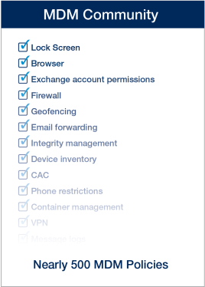








Secure Platform| Enterprise Ready
MDM Policies
Enterprise Ecosystem
MDM Agent
MDM Server
Single Sign On
IT Admin
Active
Directory Server
SSO Proxy
SSO Server
FIPS – Certified VPN
VPN Gateway
Notes:
KNOX technical details
Container
Install the KNOX container with a launcher icon, home screen and preloaded apps
Lock the container, which requires the user to enter their KNOX password to unlock
Uninstall the container
Install or uninstall an app in the container through Samsung KNOX Apps
Add or remove an app launcher icon on the KNOX home screen
Define a whitelist or blacklist of apps that can be installed in the KNOX container
Start or stop an app in the container
Write data to an app's home directory
Create a firewall around the container (for example, block the FTP port on the device from receiving connections, or block the device from connecting to the HTTP port on a web server)
Define the password policy (same capabilities as the SAFE password)
Enable or disable camera, non-secure keypad and share via list
SE for Android
Set the enforce status of SE Linux
Set the enforce status of the Android Activity Manager Service (AMS)
Write SE Linux policy file to SE for Android
Write policies for SE for Android security contexts
Map apps to SE for Android security contexts
Integrity Management
Add apps to the baseline scan
Perform a pre-baseline scan
Establish the kernel measurement baseline
Scan the kernel or installed apps in real time
Start or stop the continuous runtime integrity monitoring
Define a subscriber to receive integrity violations and results
Update the existing baseline with the new scan result
VPN
Add or remove a VPN profile
Add or remove an app to or from a VPN profile so that when the app is launched, it uses a specific VPN
Add all apps in the container to a VPN profile
Enable a default forwarding route through defined network nodes
Set the CA certificate or user certificate for a VPN profile
Enable FIPS mode
Single Sign-On (SSO)
Define a whitelist or blacklist of apps allowed to use the SSO service
Set user information
Force user to re-authenticate
Common Access Card (CAC) or SmartCard
Enable or disable CAC or SmartCard authentication for the browser or email
SAFE technical details
Data
Start encryption and decryption on a device's internal memory or external SD card
Wipe internal memory or the external SD card
Lock out the device with a specific password
Install or remove the certificates used to authenticate users for email, Wi- Fi or VPN
Set the device enrollment status with the MDM server
Power off a device
Password
Set the policy for user password patterns
Set a blacklist of strings that are not allowed in passwords
Set the number of failed password attempts before a device is disabled
Set the time a password is valid, before it must be changed
Set the number of previous passwords that cannot be used for a new password
Show the user the password as it is entered
Apps
Install, update or uninstall an app on a device
Disable the uninstallation of an app
Force all apps to be installed on an external SD card
Get a list of the apps installed on a device
Start or stop an app used on a device
Check if an app is currently in use
Get info about an app: package name, version, how much RAM/CPU/network traffic it is using, the size of code/data/cache required, last time it was launched and how long it was used
Back up or restore a device’s app data and preferences
Wipe data associated with an app
Define a whitelist or blacklist of apps or widgets that can be installed
Disable or re-enable the native browser, Play store, voice dialer, or YouTube
Add an app launcher icon to the home screen and change an app's launcher icon
Enterprise License Management (ELM)
Activate an enterprise license, which enables enterprise apps to access the MDM APIs
HIDE DETAILS
Exchange
Add or delete an MS Exchange ActiveSync account
Set the account host, domain, username, email address, password
Enable or disable Secure Sockets Layer (SSL) security
Indicate if all certificates accepted for SSL
Set the certificate to be used for SSL authentication
Enable S/MIME certificates
Synch the account with the device contacts, calendar, tasks and notes
Enable device vibration for a new email
VPN
Allow only IPsec or SSL/TLS connections
Create, update or delete a VPN profile
Configure the profile: ID, pre-shared key, CA certificate, user certificate, secret, encryption, DNS search domains/addresses and network node forwarding route
Restrictions
Enable or disable Android Beam, apps not from Google Play, audio recording, background process limits, backups to Google cloud, Bluetooth, camera, cellular data, clipboard, factory reset, Home key, microphone, mock GPS locations, NFC, OTA O/S upgrades, power button, S Beam, SD card writing, S Voice, screen captures, settings changes by user, Share Via list, status bar, tethering, USB debugging, USB storage, video recording, VPN, wallpaper and Wi-Fi
Kiosk
Enable or disable Kiosk mode, which provides a restricted version of the default Samsung home screen
Enable or disable hardware keys, multi window mode or recently used apps display
Hide the navigation bar, status bar or system bar
Geo Fencing
Create or destroy a geofence area, which can be linear, circular or polygonal
Determine if a device is within the geofence area
Set the minimum distance and time interval to monitor a geofence
Start or stop geofence monitoring

Slide 25
Samsung KNOX | Active Directory Based Management*
AD-based Group Policy management for Containers and Devices
Cloud-based service deploys in minutes — leveraging existing infrastructure
Lower cost of ownership with self-service with full lifecycle automation
Supports SAFE v4 policies and KNOX policies
Unified cross-platform device & desktop management
*Provided by Centrify
Notes:
Note something about AD-ready for free

Slide 26




Samsung KNOX | Samsung Mobile Devices
NOTE 3
GALAXY S4
NOTE 2
GALAXY S3
NOTE 10.1 (2014)
Many more to come…

Slide 27
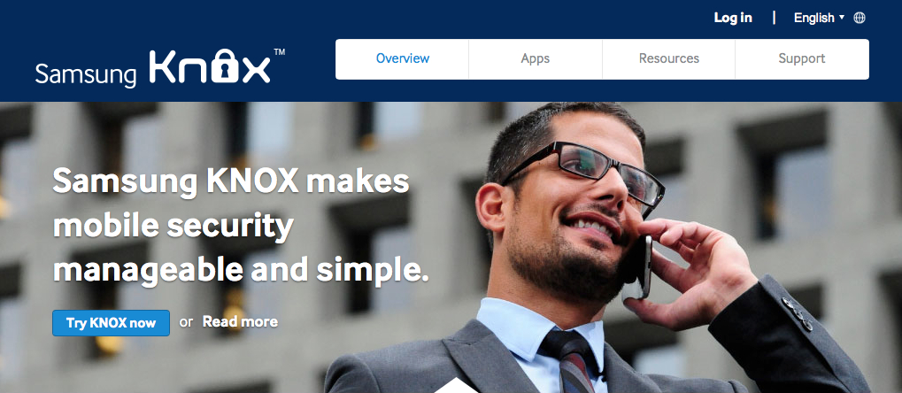
Samsung KNOX | Find Out More
www.samsungknox.com/

Slide 28


Slide 29

The Next Secure Enterprise Mobile Platform

